Slide 1
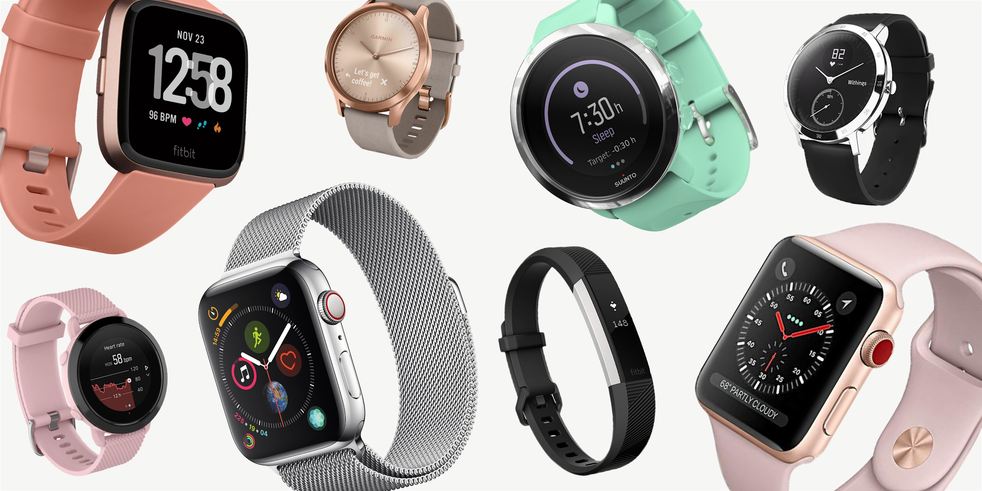
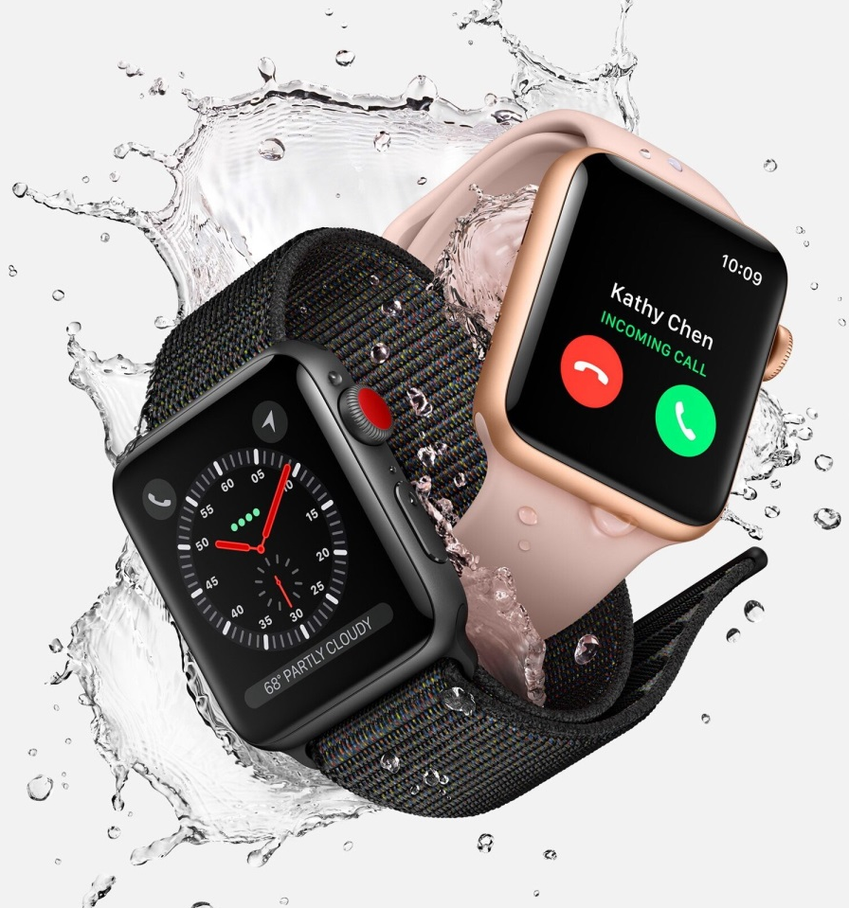
Smart Watches
How we can improve them?

Slide 2
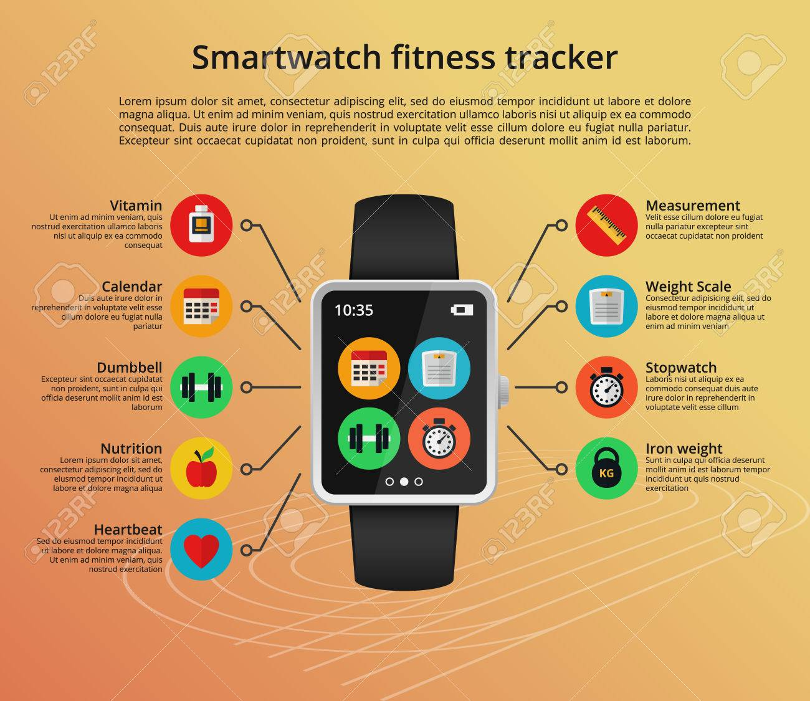
Motivations for doing smartwatches
More efficient - reply to calls and text instantly
Fitness tracker - better improve fitness
Smartphone on your wrist

Slide 3
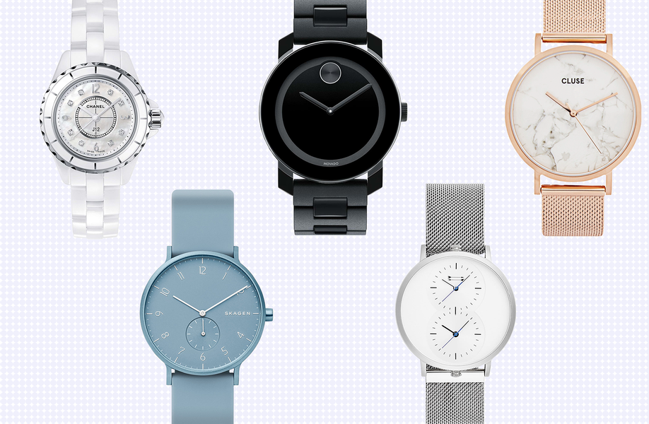
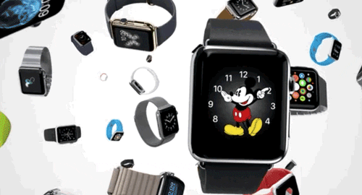
What is a “Smart Watch”
Used to be a device to tell time
but now they are mini-computers on your wrist
A smartwatch is a portable device that's designed to be worn on a wrist. Smartwatches — like smartphones — use touchscreens, offer apps, and often record your heart rate and other vital signs - Lifewire

Slide 4
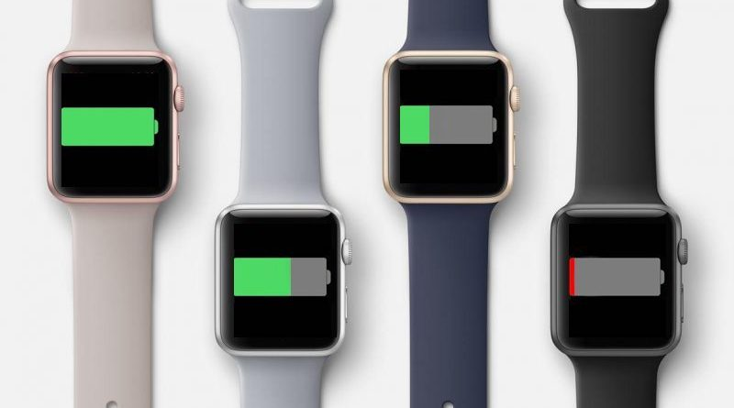
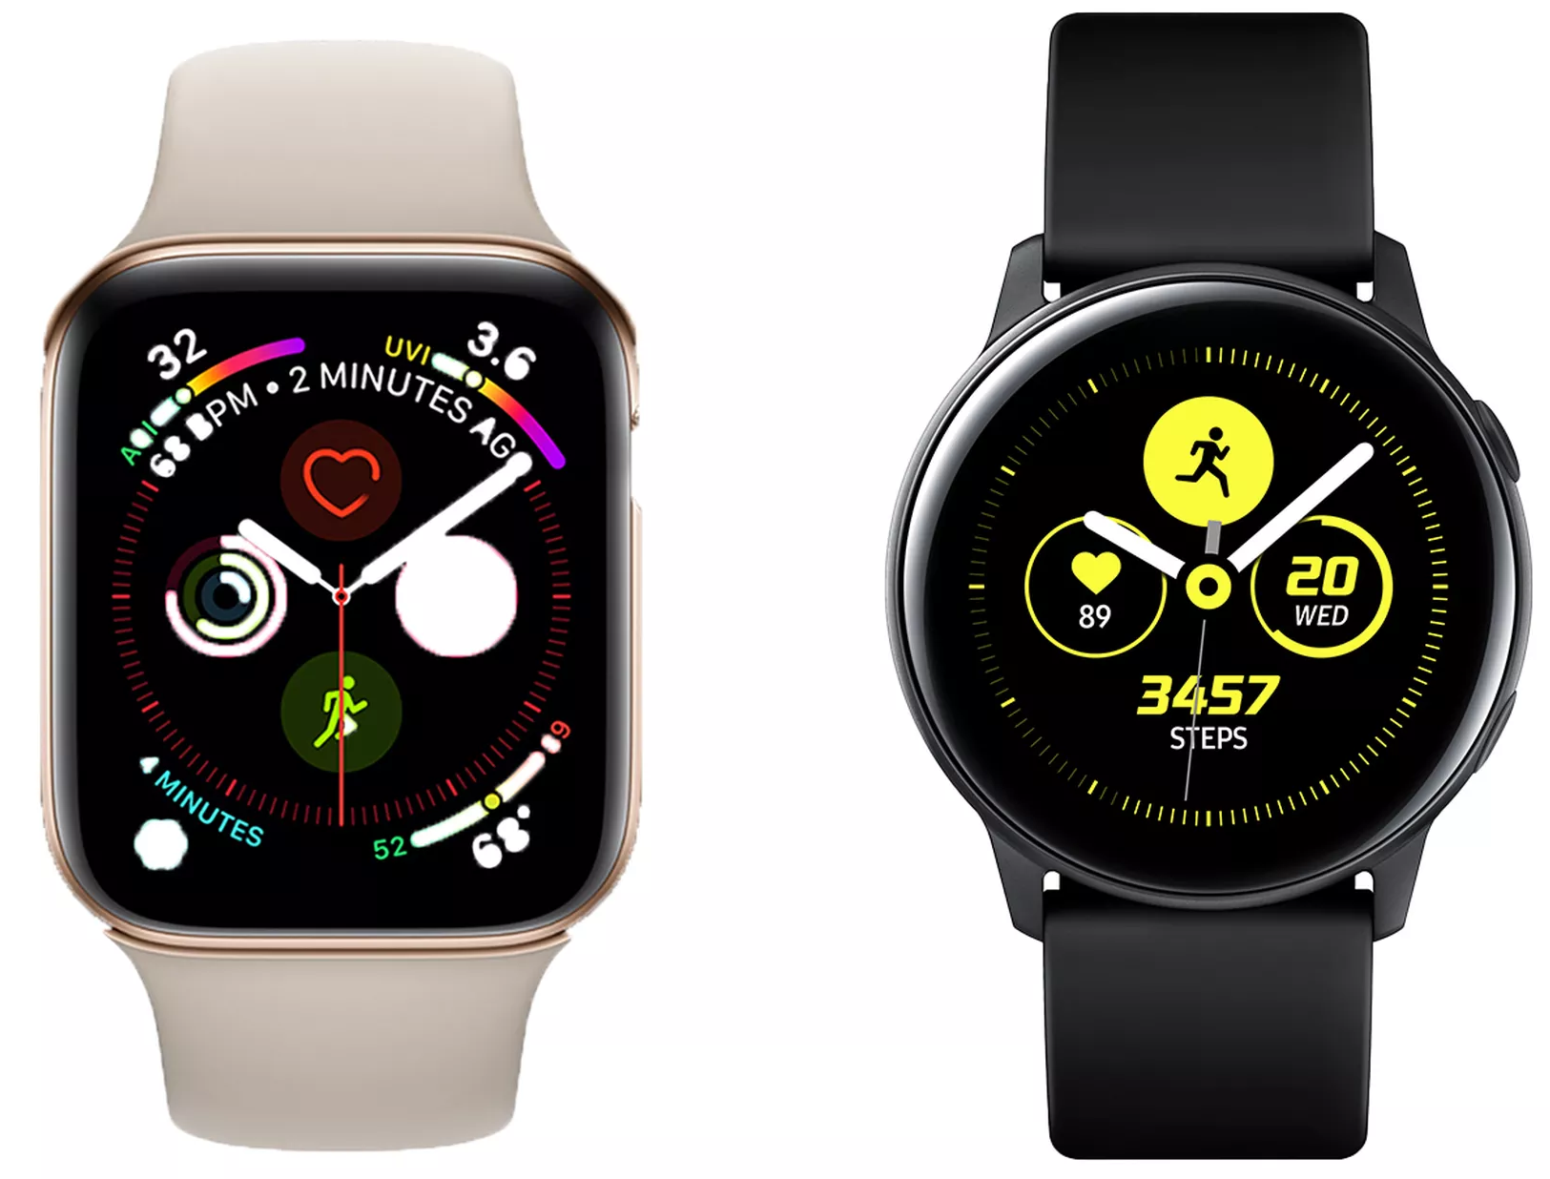
How we can improve them?
Battery life
Improve battery
User interface
interfaces are hard to navigate
Cost
Prices for a good smart watch is high
Apple: 18 hours
*varying on model
Samsung: 3 days
*varying on model
Size/weight
Functionality
Notifications, apps, fitness tracker
Comfort/Style
uncomfortable and unstylish
Apple
Samsung
$199 - $699
*varying on model

Slide 5
References
https://electronics.howstuffworks.com/gadgets/clocks-watches/smart-watch.htm
https://www.lifewire.com/an-introduction-to-smart-watches-3441381

